Slide 1
Unsupervised FAQ Retrieval with Question Generation and BERT
CSE712: Symbolic Machine Learning II
Yosi Mass, Boaz Carmeli, Haggai Roitman and David Konopnicki
Presented by
Group #3
20166008 | Sakib Ahmed
20266002 | Abu Nayeem Tasneem
20266007 | Mosarrat Rumman
20266022 | Sahiba Tasneem
20266013 | Mofaqkhayrul Islam
20266009 | Najib Murshed
21166020 | Md. Tarikul Islam

Slide 2
Introduction
An unsupervised FAQ retrieval method using distant supervision to train Neural Models
Proposed unsupervised model is on par and even outperforms supervised models
One unsupervised re-ranker and two fine tuned unsupervised BERT model
Previously, CNN & LSTM were used for FAQ retrieval methods. And also using supervised BERT models for Q-to-a matching(Sakata et al., 2019)
Index FAQ pairs (q, a) ElasticSearch Retrieve top-k FAQ Candidates using BM25 similarity
First Unsupervised Re-ranker using maximum-passage bm25-maxpsg
Unsupervised BERT model for Q-to-a re-ranking
Unsupervised BERT model for Q-to-q re-ranking
Combine Three(03) re-rankers using CombSUM & PoolRank late-fusion

Slide 3
Unsupervised FAQ Retrieval Approach
Indexing and initial candidates retrieval
Set {(q, a)} and user query (Q)
Indexing and retrieving initial candidates (sets {(q, a)}).
ElasticSearch and BM25 similarity between (q+a) and Q is used to retrieve top-K candidates.
Passage-based re-ranking
Sliding window on (q+a) text field.
Rank the passage with highest BM25 similarity to Q.
BERT model for Q-to-a similarity
BERT-Q-a re-ranks {(q,a)} according to similarity between Q and each pair’s answer a.
Fine tuning of BERT using triplets (q, a, a’).
Selective sampling of negative answers for better learning.
(q, a) pairs are ranked using score of each (Q, a) pair assigned by fine tuned BERT-Q-a

Slide 4
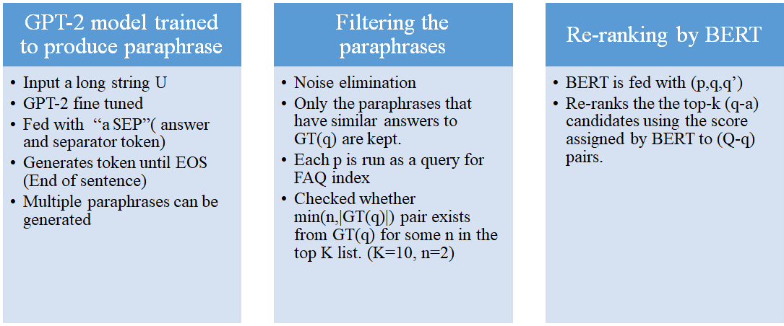

4. BERT Q-q similarity

Slide 5
5. Re-Rankers combined
CombSUM -provides a combined sum by summing all the scores of each candidate assigned by the 3 re-anking methods.
Pool Rank method takes the top candidates from CombSum.
RM1 model - an unsupervised query expansion step which is used to re-rank the whole candidates pool

Slide 6
Datasets and Technology
Datasets:
There have been used two types of datasets.
i) FAQIR (derived from Yahoo! Answers community QA (CQA))
ii). StackFAQ (derived from the “web apps” domain of the StackExchange CQA)
For the above datasets, comparison have been made against below method’s result like-
i) RC – an ensemble of three unsupervised methods (BM25, Vector-Space and word-embeddings);
ii) ListNet and LambdaMART two supervised model trained over a diverse set of text similarity features;
iii) CNN-Rank – a (supervised) learning-to-rank approach based on a CNN.
StackFAQ dataset combined below methods
i. TSUBAKI (a search engine for Q-to-q matching);
ii. Supervised fine-tuned BERT model (for Q-to-a matching).
Technology:
ElasticSearch is used to index the FAQ pairs and to fine-tune GPT-2 for generating the question paraphrases OpenAI’s Medium-sized GPT-2 English model (24-layer, 1024-hidden, 16-heads, 345M parameters) is used.

Slide 7
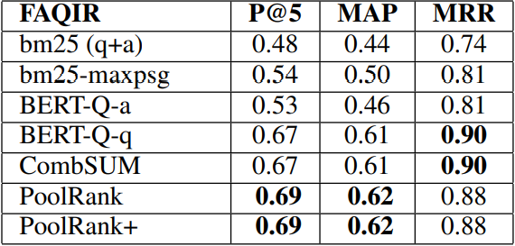
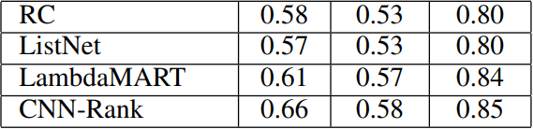
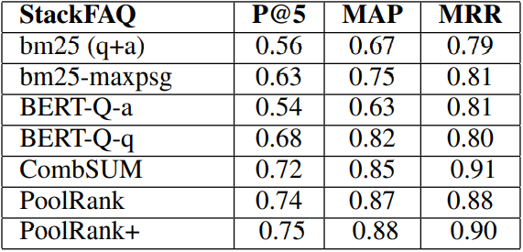
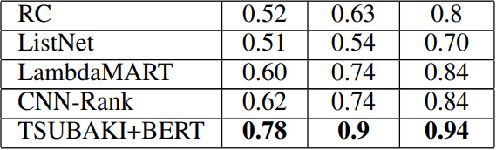
Result Comparison
Metrics of Comparison:
P@5 (Precision at top 5 recommendations)
MAP (Mean Average Precision)
MRR (Mean Reciprocal Rank)
Unsupervised Performance Supervised Performance
Results:
BERT Q-q is the best reranker comparing to other BERTs, strengthening claims of previous papers
PoolRank+, the enhanced late fusion version, performs better than most and even comes close to the level of TSUBAKI + BERT, the current dominating model, in terms of performance

Slide 8
Conclusion
Learn extractive QA behavior without the use of labeled QA data.
Overcome the “unsupervised gap” by generating high-quality question paraphrases.
Computational resources needed to train/fine-tune the BERT model.
XL Net handles long text sequence.

Slide 9
References
Stephen Robertson and Hugo Zaragoza. 2009. The probabilistic relevance framework: BM25 and beyond. Found. Trends Inf. Retr., 3(4):333–389.
Yosi Mass, Haggai Roitman, Shai Erera, Or Rivlin, Bar Weiner, and David Konopnicki. 2019. A study of bert for non-factoid question-answering under passage length constraints. CoRR, abs/1908.06780.
Alec Radford. 2018. Improving language understanding by generative pre-training.
Wataru Sakata, Tomohide Shibata, Ribeka Tanaka, and Sadao Kurohashi. 2019. FAQ retrieval using query question similarity and bert-based query-answer relevance. CoRR, abs/1905.02851..
Oren Kurland and J. Shane Culpepper. 2018. Fusion in information retrieval: Sigir 2018 half-day tutorial. In The 41st International ACM SIGIR Conference on Research and Development in Information Retrieval, SIGIR ’18, pages 1383–1386, New York, NY, USA. ACM.
Victor Lavrenko and W. Bruce Croft. 2001. Relevance based language models. In Proceedings of the 24th Annual International ACM SIGIR Conference on Research and Development in Information Retrieval, SIGIR ’01, pages 120–127, New York, NY, USA. ACM.
Mladen Karan and Jan Snajder. 2018. ˇ Paraphrase focused learning to rank for domain-specific frequently asked questions retrieval. Expert Systems with Applications, 91:418 – 433.
https://www.elastic.co/

